Slide 1
Just Culture
By Matthew Rozendaal

Slide 2
What does Just Culture Mean?
A model that focuses on learning rather than blaming
Mistakes come from systematic failures not a single person
Organizations should respond fairly and consistently

Slide 3

Barrier: Blame Culture
Leaders default to punishment
Staff may be labeled as careless
Severe mistakes can trigger harsher responses

Slide 4
Barrier: Fear of Consequences
Fear of Job Loss
Legal Consequences
Damage to reputation
Being humiliated

Slide 5
Barrier: Lack of Transparency
Employees don’t understand how investigations work
The line is blurry between human error and negligence

Slide 6
Barrier: Negativity toward Investigations
Staff may feel like Investigations are punishments
Reporting doesn’t lead to visible improvements
Leadership may focus more on compliance compared to learning

Slide 7
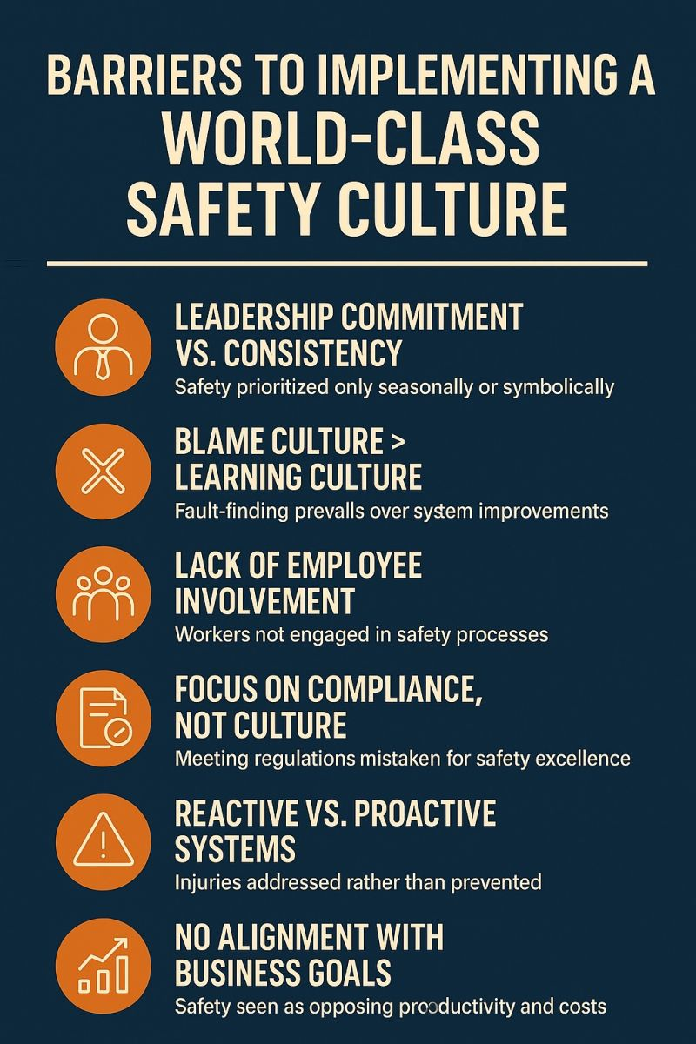
(Malviya, 2025)

Slide 8
References
Just Culture Overview. (n.d.). Retrieved July 7, 2026, from https://stanfordhealthcare.org/content/dam/SHC/health-care-professionals/medical-staff/annual-physician-education/justculturesep2025.pdf
Just Culture Principles – Health Quality Alberta- Just Culture. (2026). Justculture.Hqa.Ca. https://justculture.hqa.ca/just-culture-principles
Sofronio Jadulco. (2025, February 28). Just Culture - Definition and Explanation. The Oxford Review - OR Briefings. https://oxford-review.com/the-oxford-review-dei-diversity-equity-and-inclusion-dictionary/just-culture-definition-and-explanation/
Malviya, K. (2025, August 7). Barriers to implementing a World-Class Safety Culture. LinkedIn. https://www.linkedin.com/posts/kamesh-malviya-a5871434_safetyculture-workplacesafety-leadership-activity-7354468122331901953-1BL6?utm_source=share&utm_medium=member_desktop&rcm=ACoAACAEkJEBvik8LVdNesLWV-hkX-Wh21gCuzI

